Slide 1
Sequence conservation

Slide 2
Conservation in sequences
Measures of conservation (protein alignments)
Variability
Entropy
Diversity
Physicochemical properties
Functional residues
Consurf
Sequence Harmony
Phosphosites
Correlated evolution
Measuring conservation in DNA

Slide 3
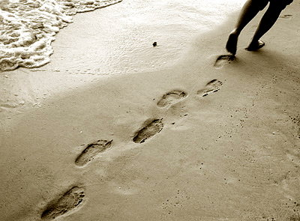
Functions leave footprints in genomes
Evolutionary footprints
Genomic context
Gene fusions
Conserved neighborhood
Co-occurrence
Correlated evolution
Sequence footprints

Slide 4
Evolution
Nothing in biology makes sense except in the light of evolution (Dobzhansky, 1973)

Slide 5
Conservation
Due to random changes, elements that are not ‘important’ tend to be not conserved
Elements that have important functions tend to be conserved

Slide 6
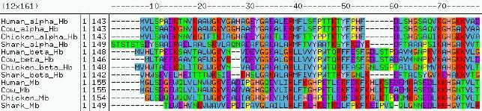
Some positions more conserved than others
0.000 # ---S-------- 0.000 # ---T-------- 0.000 # ---S-------- 0.000 # ---T-------- 0.000 # ---S-------- 0.024 # ---TM-M----- 0.320 # MMMSV-VVMM-- 0.278 # VVVDHMHHGGG- 0.500 # LLLYLLWWLLL- 0.603 # SSSSTTTSSSS- 0.391 # PAAAPAAEDDD- 0.424 # AAAAEEEVGGQT 0.809 # DDDDEEEEEEEE

Slide 7
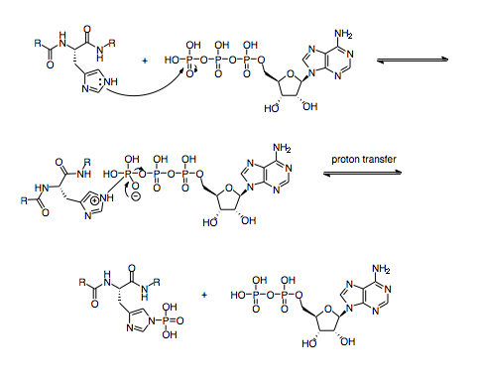
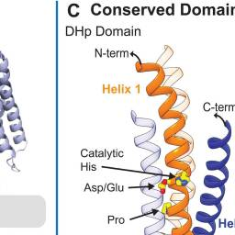
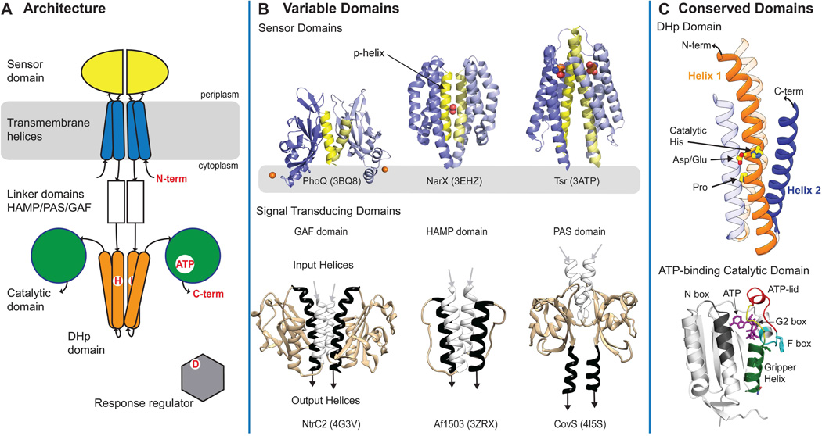
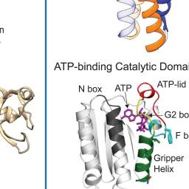
Histidine kinase mechanism
Bhate et al, Structure 2015
Notes:
Two-component system architecture
(A) Schematic representation of a canonical TCS. Many of these domains are repeated in other protein classes. The DHp is the catalytic core of Histidine Kinases. (B) Variable domain structures from three sensor and signal transducing domains colored to highlight key features. The yellow helix (top) shows the dimeric interface. The white and black helices (bottom) show input and output helices. (C) Structures of conserved domains, DHp and catalytic, colored to highlight various features. DHp dimeric structure (top) has the N-terminal helix colored in orange and the C-terminal helix in blue. Critical regions for function are labeled and color-coded in the CA structure (bottom).

Slide 8
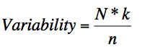
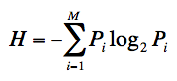
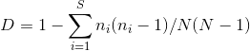
Ways of measuring conservation
Variability
Wu-Kabat 1977
N: the number of sequences in the alignment, k: the number of different amino acids at a given position and n: frequency of he most common amino acid at that position
Shannon Entropy
Pi: fraction of residues of amino acid type i, M: number of amino acid types (20)
Shannon 1948 (Sander & Schneider 1991)
Simpson Diversity
ni: number of residues of type i, N: total number of residues counted and S: number of different symbol types per site
Physicochemical properties
Taylor 1986

Slide 9
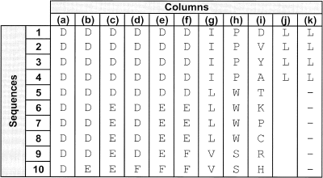
Example
K 1 2 2 2 3 3 4 3 10
n 10 9 5 9 5 5 4 4 1
S 1 2 2 2 3 3 3 3 10
0.5
N=10
V 1 2.2 4 2.2 6 6 10 7.5 100
H 0 0.5 1 0.5 1.4 1.5 1.5 1.5 3.3
D 0 0.2 0.6 0.2 0.6 0.7 0.7 0.7 1
-P_{i}log₂P_{i}
H = -1*(0.9 log(0.9)+0.1 log(0.1))
D = 1- (9*8+1*0)/(10*9)
0
0
P_{i}
1

Slide 10
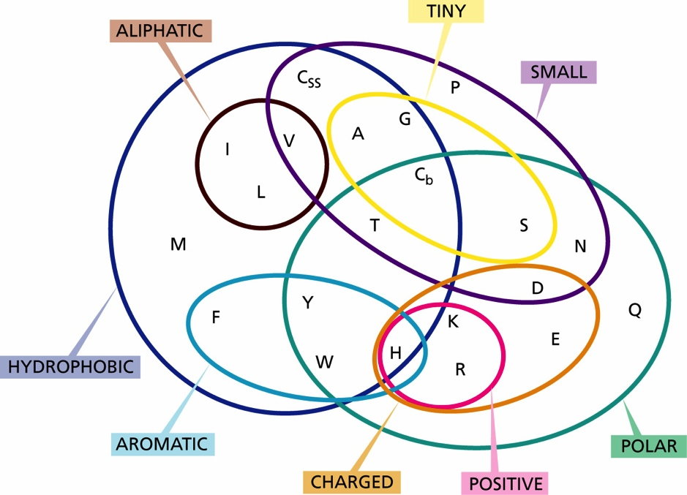
Physicochemical properties of amino acids
Proline
P: crossed properties
N: Total number of properties
Cn = N-P
L
L
R
R
P = 5 and Cn = (10 - 5) = 5
Negative
Livingstone and Barton, 1993

Slide 11
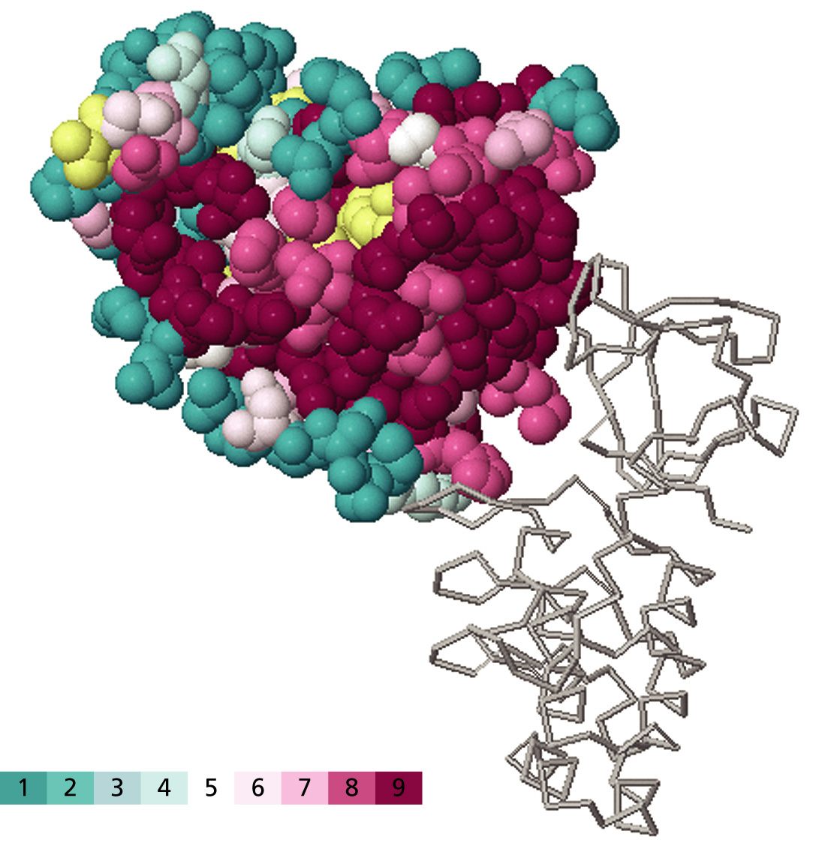
Conserved patches can identify binding sites
ASPP2/DNA Binding site of p53
Conservation

Slide 12
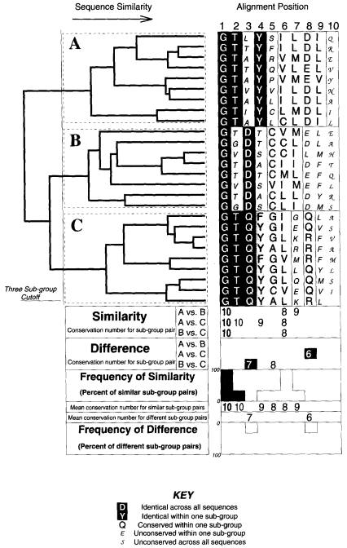
key residues determine
functional differences between protein subfamilies
Livingstone and Barton, 1993

Slide 13
Implementing a score
Sequence Harmony (based on Shannon Entropy)
SH_{i} = S_{i}^{A+B} – ½(S_{i}^{A} + S_{i}^{B})
The SH function becomes zero for maximally different sites and one for sites with identical distributions.
Pirovano et al, NAR 2006

Slide 14
Example Sequence Harmony
Hypothetical alignment of two subfamilies A (4 sequences) and B (6 sequences)
Group A
seq1 R E L A A A K K
seq2 R E L A A F K K
seq3 R E A A A Y R K
seq4 R E A A A F R K
Group B
seq1 H N V A A Y R K
seq2 H N V F F Y R K
seq3 H N F F A F K K
seq4 H S F F F Y R K
seq5 H S M F F F K K
seq6 H T M F F Y K K
SH 0.00 0.00 0.00 0.35 0.54 0.79 1.00 1.00
Pirovano et al, NAR 2006

Slide 15
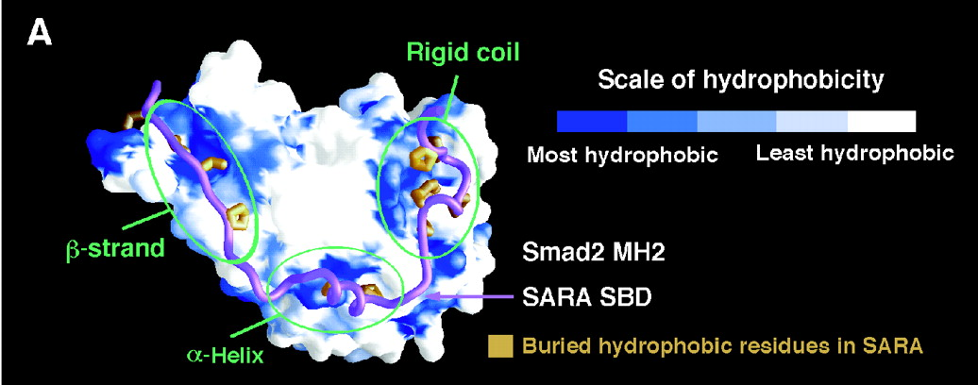
SMAD subtypes
Prediction of residues important for interaction with SARA
Wu et al, Science 2000

Slide 16
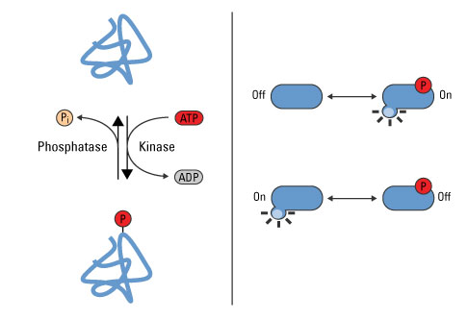
Phosphorylation of proteins

Slide 17
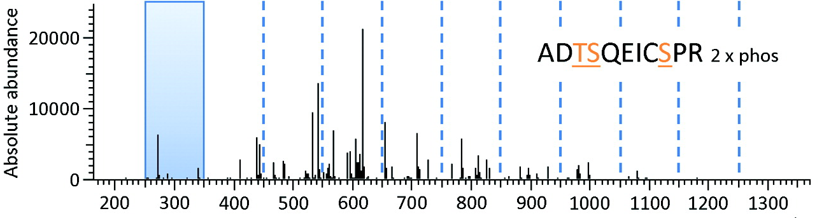
Phosphorylation mass spectrometry

Slide 18
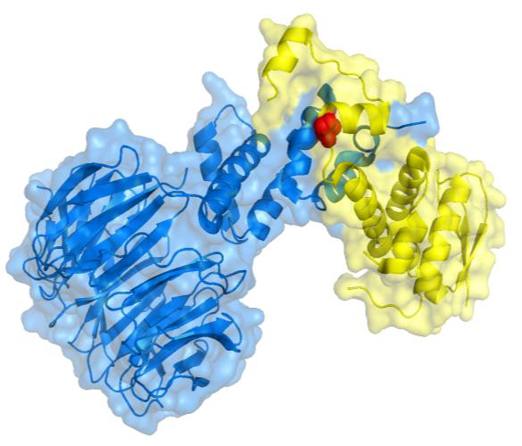
Functions of phosphorylations
Regulation of Skp1-Met3 interactions

Slide 19
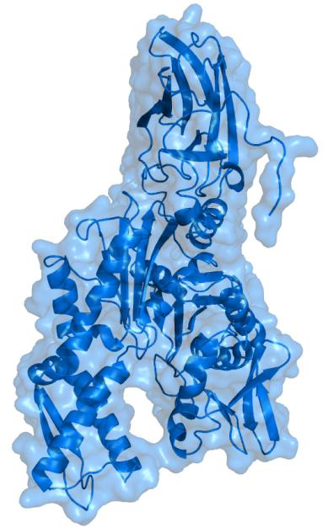
Functions of phosphorylations
Regulation of Hsp70 domain activity

Slide 20
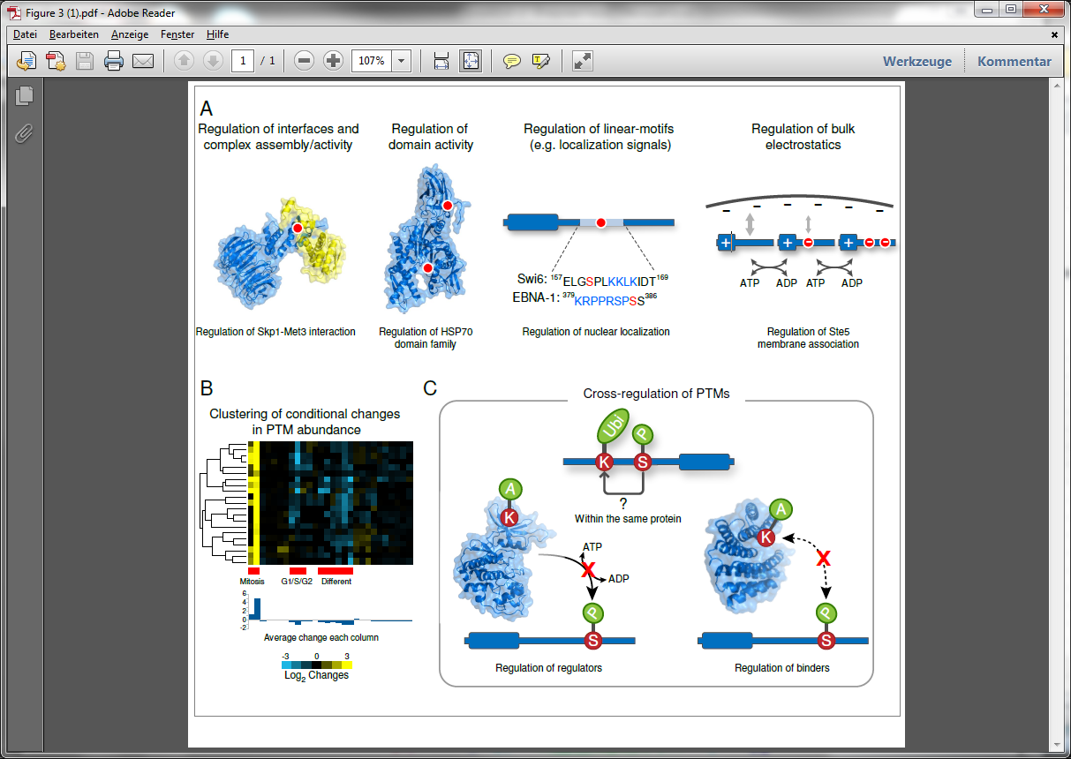
Functions of phosphorylations
Changing bulk electrostatics

Slide 21
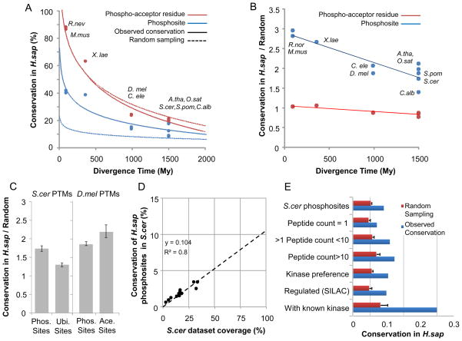
Beltrao et al, Cell 2012
Notes:
A) We analyzed the conservation of 10 phosphoproteomes against that of H.sapiens using protein alignments of 1-to-1 orthologs. For each species, we compared the conservation of the phosphoacceptor residues (i.e. sequence conservation) with the conservation of phosphorylation site based on the MS experimental evidence. A random expectation or null model for each case was determined based on the random shuffling of phosphosite positions within each human protein. B) Ratio of observed conservation over random expectation. C) Ratio of conservation over random expectation ratio for different PTMs. D) Predicted coverage and conservation in H.sapiens for 12 different previously reported phosphoproteomics experiments for S.cerevisiae. E) To access the impact of data quality on the conservation values we made use of different criteria to define subsets of S.cerevisiae phosphosites. For each subset we calculated the observed conservation inH.sapiens as well as the expected value based on random sampling.

Slide 22
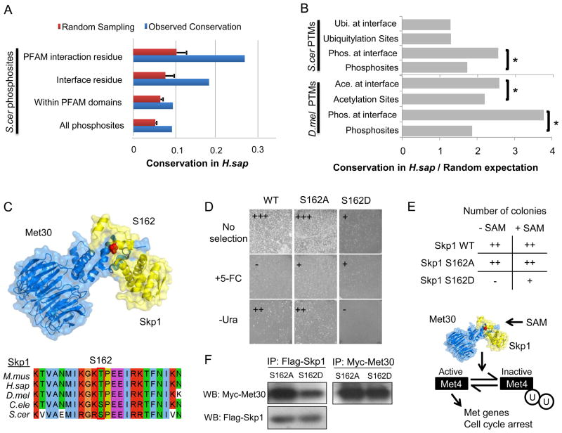
PTMs in interactions more conserved
Beltrao et al, Cell 2012

Slide 23
Conserved PTM in interface
Beltrao et al, Cell 2012

Slide 24
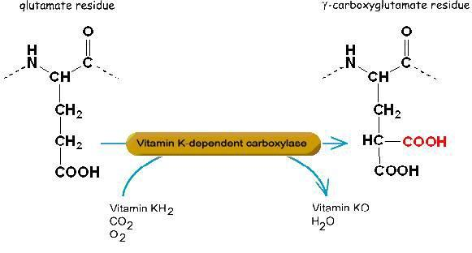
Carboxylation

Slide 25
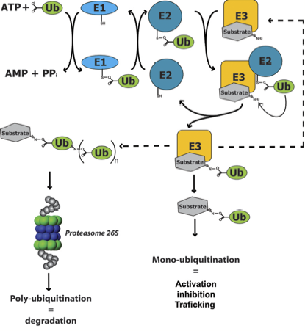
Ubiquitination

Slide 26
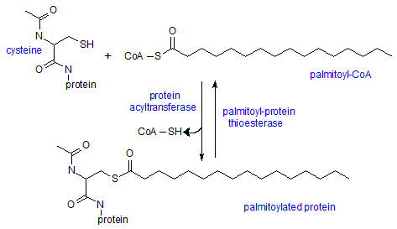
palmitoylation

Slide 27
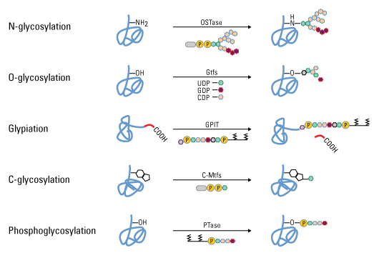
Protein glycosylation

Slide 28
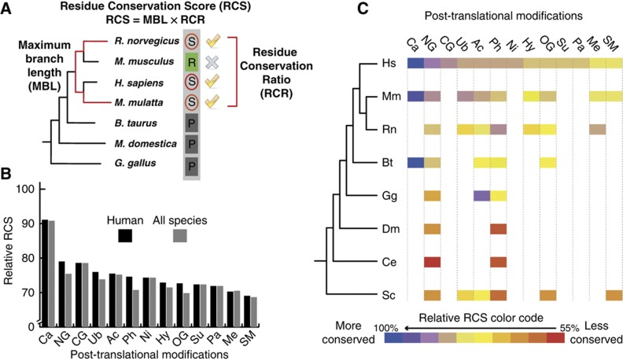
Carboxylation most conserved PTM
Minguez et al, MSB 2012

Slide 29
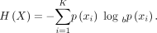
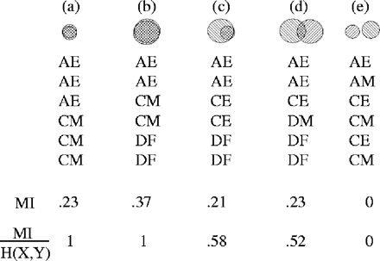
Co-evolving sites
MI
Normalized by maximum
entropy
Martin et al , Bioinformatics 2005

Slide 30
Co-evolving sites are often in physical proximity
> 10 aa apart
High normalized MI
20 – 50% in close proximity
10-14% side-chain contact
Martin et al , Bioinformatics 2005

Slide 31
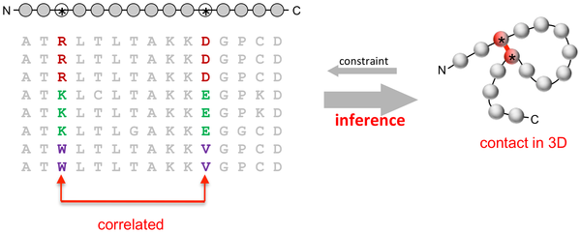
EVfold
Marks et al, PLoS ONE 2011

Slide 32
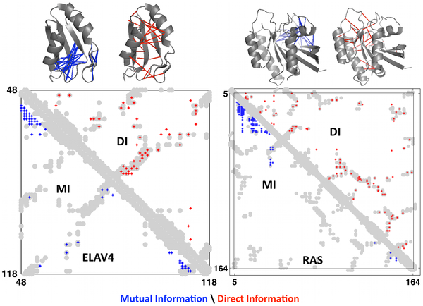
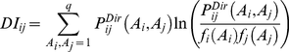
Evfold: Direct Information predicts structural contacts
Normalized MI

Slide 33
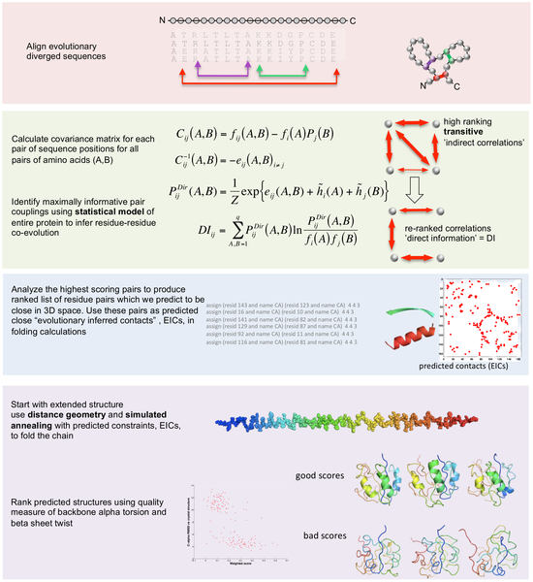
EVFold

Slide 34
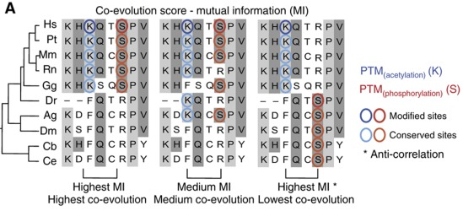
Co-evolution of PTM sites
Minguez et al, MSB 2012

Slide 35
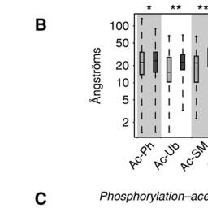
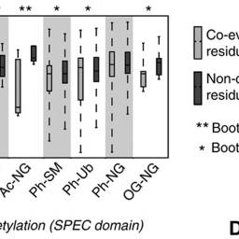
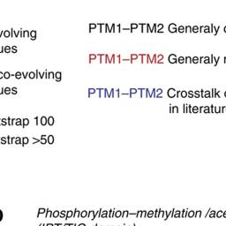
Co-evolving PTM sites are close in 3D

Slide 36
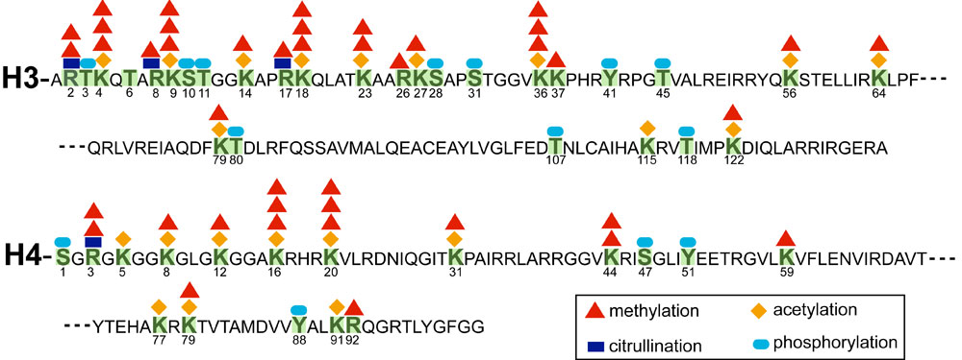
Histone code

Slide 37
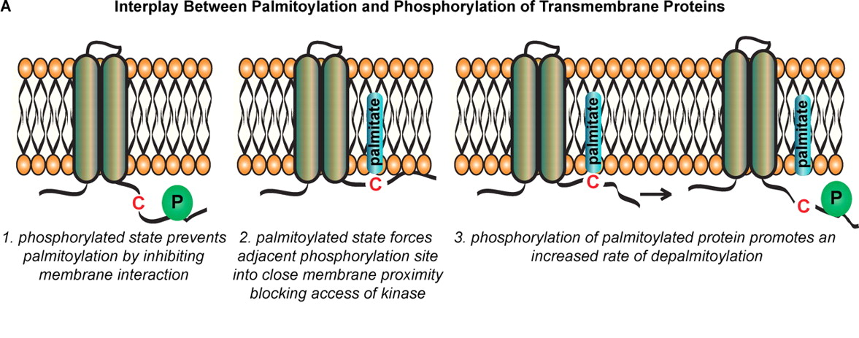
Phos and palmitoylation

Slide 38
Types of PTM-interactions
Notes:
Two different PTM types have been observed to cross-regulate each other in the same protein where for example a phosphosite may recruit an E3-ligase promoting protein ubiquitylation. The regulatory enzyme of one type can be regulated by modification of another type such as the regulation of protein kinases via acetylation (regulation of regulators). Additionally, a binder for one PTM type may be regulated by a modification site of a different type. This has been observed for 14-3-3 domains which can bind phosphosites and have been shown to be regulated by acetylation (regulation of regulators).

Slide 39
Conservation of non-coding DNA
Comparative studies suggest many regulatory elements are still missing from annotation in vertebrates and mammals
VISTA identifies elements in the genome with >70% sequence identity over at least 100 bp
Phylogenetic shadowing makes use of phylogenetic information, multiple substitutions and patterns such as transition/transversion ratio’s.
phastCONS is based on a phylogenetic Hidden Markov Model. Sequences are classified into states conserved, nonconserved.

Slide 40
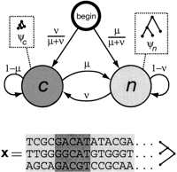
Phylo-HMM in phastCONS
Siepel et al, Genome Research 2005
Notes:
State-transition diagram for the phylo-HMM used by phastCons, which consists of a state for conserved regions (c) and a state for nonconserved regions (n). Each state is associated with a phylogenetic model (ψ_{c} and ψ_{n}); these models are identical except for a scaling parameter ρ (0 ≤ ρ ≤ 1), which is applied to the branch lengths of ψ_{c} and represents the average rate of substitution in conserved regions as a fraction of the average rate in nonconserved regions (see Methods). Two parameters, μ and ν (0 ≤ μ, ν ≤ 1), define all state-transition probabilities, as illustrated. The probability of visiting each state first (indicated by arcs from the node labeled “begin”) is simply set equal to the probability of that state at equilibrium (stationarity). The model can be thought of as a probabilistic machine that “generates” a multiple alignment, consisting of alternating sequences of conserved (dark gray) and nonconserved (light gray) alignment columns (see example at bottom).

Slide 41
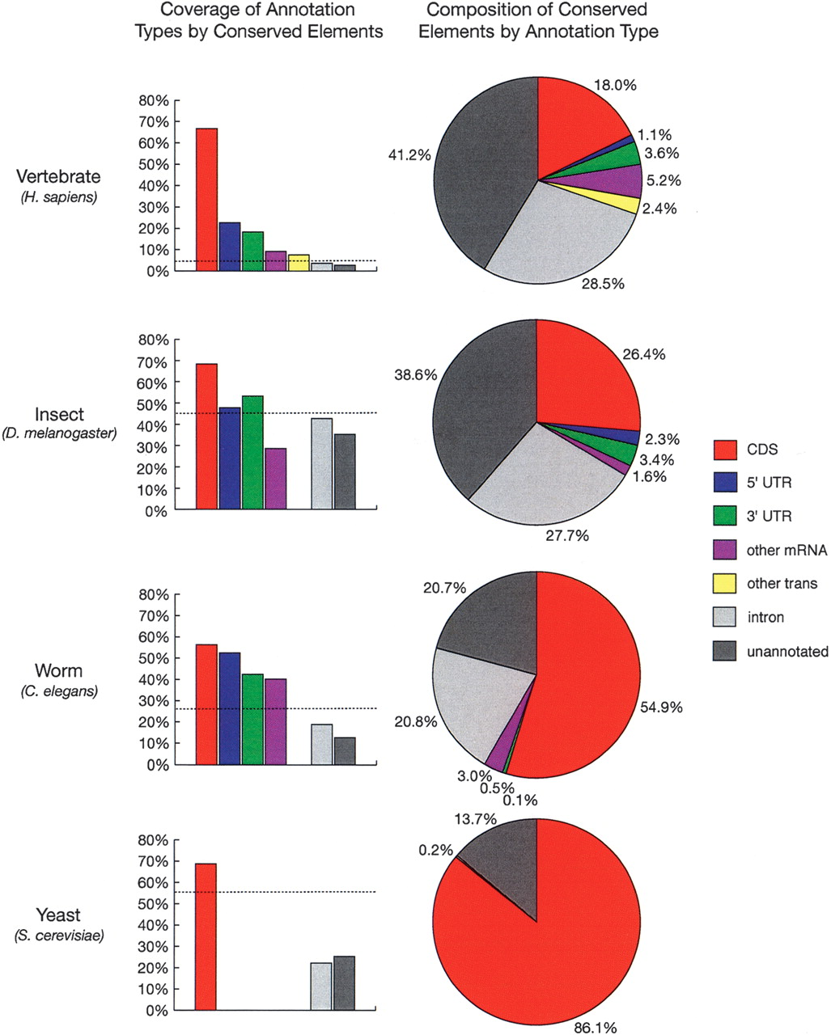
Notes:
Fractions of bases of various annotation types covered by predicted conserved elements (left) and fractions of bases in conserved elements belonging to various annotation types (right). Annotation types include coding regions of known genes (CDS), 5′ and 3′ UTRs of known genes, other regions aligned to mRNAs or spliced ESTs from GenBank (other mRNA), other transcribed regions according to data from Phase 2 of the Affymetrix/NCI Human Transcriptome project (other trans; see Methods), introns of known genes, and other regions (unannotated). All annotations were for the reference genome of each species group and all fractions were computed with respect to these genomes (see Methods). Dashed lines in column graphs indicate expected coverage if conserved elements were distributed uniformly. Transcriptome data was available for the vertebrates only, and UTRs and other mRNAs were omitted for yeast because of sparse data. Note that these graphs change somewhat (but not dramatically) under alternative calibration methods (see Supplemental material).

Slide 42
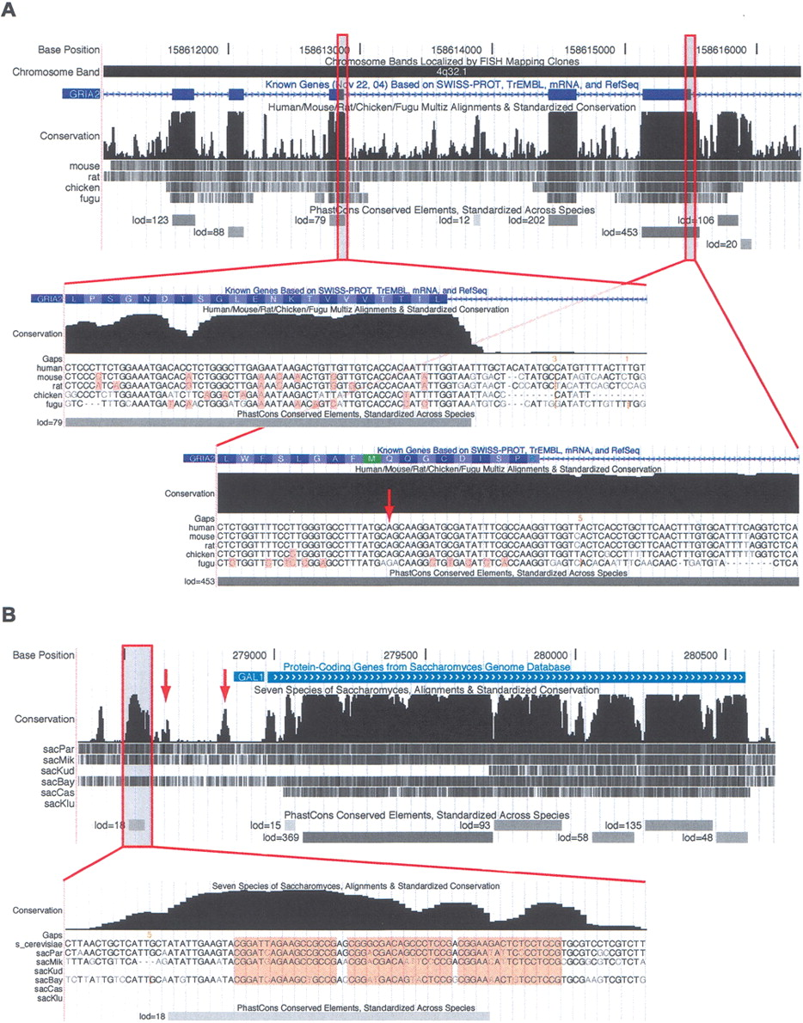
phastCons browser

Slide 43
phastCons browser
GAL4-binding site
promoter
Notes:
Screen shots of the conservation tracks in the (A) human and (B) S. cerevisiae UCSC Genome Browsers. Each conservation track has two parts, a plot of conservation scores, and beneath it, a display showing where each of the other genomes aligns to the reference genome. (Darker shading indicates higher BLASTZ scores; white indicates no alignment.) A separate track labeled “PhastCons Conserved Elements” shows predicted conserved elements and log-odds scores. In A, exons 7–11 of the RNA-edited human gene GRIA2 are shown. Peaks in the conservation plot generally correspond to exons and valleys to noncoding regions, but a 158-bp conserved noncoding element can be seen near the 3′ end of exon 11. This conserved element includes the editing complementary sequence (ECS) of the RNA editing site in exon 11. The displays seen when zooming in to the base level at a typical exon (left) and in the region of the RNA editing site (right; see arrow) are shown as insets. On the left, several synonymous substitutions are visible (highlighted bases) and the elevated conservation abruptly ends after the splice site, while on the right, there are fewer synonymous substitutions and the elevated conservation extends into the intron. In the base-level display, the vertical orange bars and numbers above them indicate “hidden” indels and their lengths—i.e., deletions in the human genome or insertions in other genomes. In B, the S. cerevisiae GAL1 gene and 5′-flanking region are shown. Strong cross-species conservation can be seen in the regulatory region upstream of the promoter, as well as in the protein-coding portion of the gene. The conserved element shown at bottom overlaps three GAL4-binding sites (highlighted in base-level view). A fourth GAL4-binding site also is reflected by a small bump in the conservation scores (left arrow), as is the promoter itself (right arrow).

Slide 44
Summary
Conserved sites have important functions (in proteins and DNA)
Conservation in sub-groups can point to specificity determining residues
Conservation of PTM residues points to functional PTMs
Co-evolving (PTM) residues interact

Slide 45
Assignment

Slide 46
Phosphorylation conservation
Find the protein MPN665 from UniProt
What is the species distribution of this protein coding gene? (Hint: use STRING)
What are the predicted interactors.
Is it part of an annotated pathway?
In the supplementary tables of ‘Cross-talk ..’ find which residues of MPN665 are phosphorylated ( www.embopress.org/doi/full/10.1038/msb.2012.4 ) Table S2
Given the species distribution do you expect the phosphorylation sites to be conserved?
Find the alignments in eggNOG and calculate the conservation in bacteria for each phosphosite of MPN665 (eg using Protein Variability Server http://imed.med.ucm.es/PVS/ )
Do you expect these phosphosites to have an important function?

Slide 47
Homework
Read SequenceHarmony and msb20124

